Slide 1
SQL COMMANDS
Food-Beverage-Industry Insights
Data Analyst
Devansh Beri

Slide 2

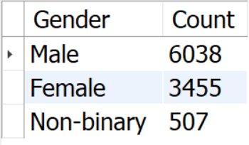
Who prefers energy drink more?

Slide 3

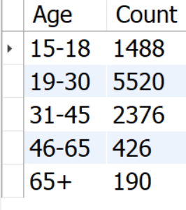
Which age group prefers energy drinks more?

Slide 4

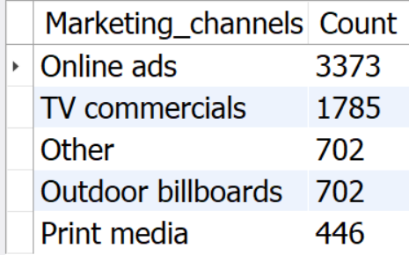
Which type of marketing reaches the most Youth?

Slide 5

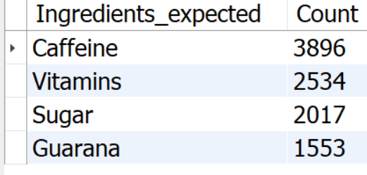
What are the preferred ingredients of energy drinks among respondents?

Slide 6

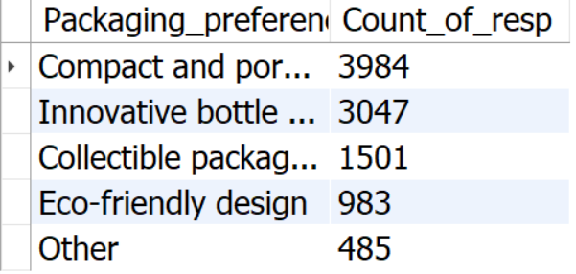
What packaging preferences do respondents have for energy drinks?

Slide 7

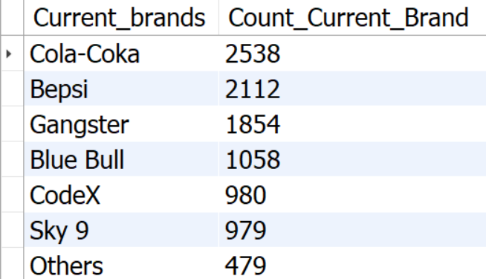
Who are the current market leaders?

Slide 8

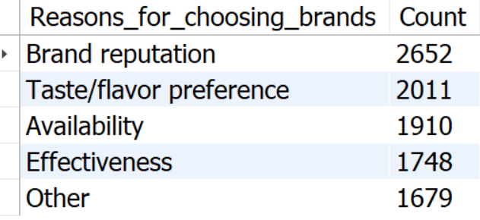
What are the primary reasons consumers prefer those brands over ours?

Slide 9

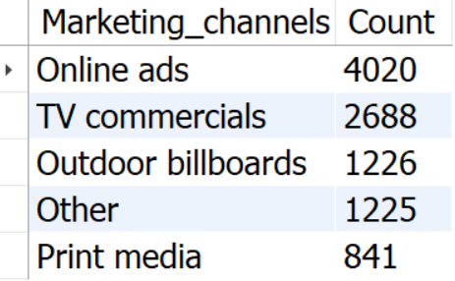
Which marketing channel can be used to reach more customers?

Slide 10

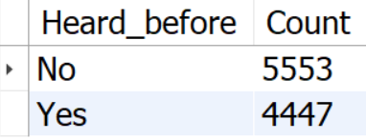

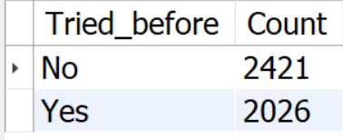

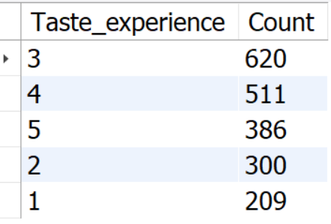
What do people think about our brand?

Slide 11

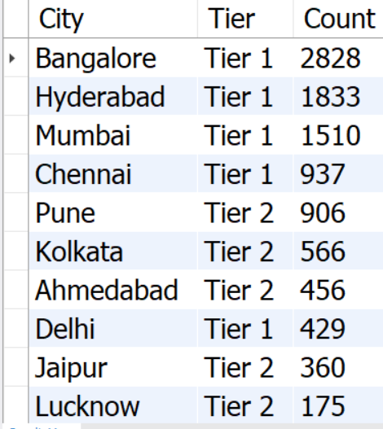
Which cities do we need to focus more on?

Slide 12

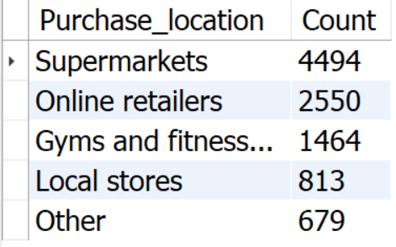
Where do respondents prefer to purchase energy drinks?

Slide 13

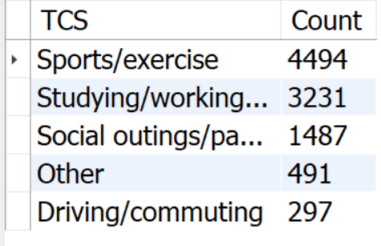
What are the typical consumption situations for energy drinks among respondents?

Slide 14

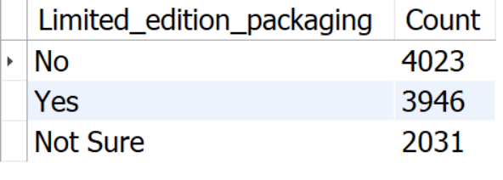

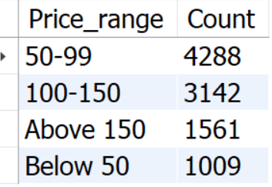
What factors influence respondents' purchase decisions’?

Slide 15

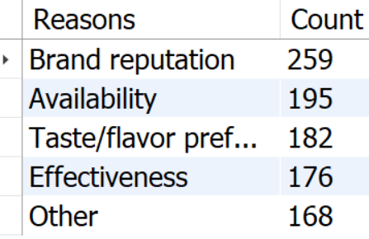
Which area of business should we focus more on our product development?

Slide 16
THE END

